Slide 1
RSI Moving Avg Crossover Strategy
Boiler Quant Trading Strategy
PARTH GUPTA

Slide 2
Explaining the Strategy - RSI
An RSI of over 70 means commodity is overbought
RSI of under 30 means commodity is oversold
RSI is an indicator of momentum

Slide 3
Explaining the Strategy - SMA 50
If price is above SMA → signals an uptrend
If price is below SMA → signals a downtrend
SMA is an indicator of the dominant trend

Slide 4
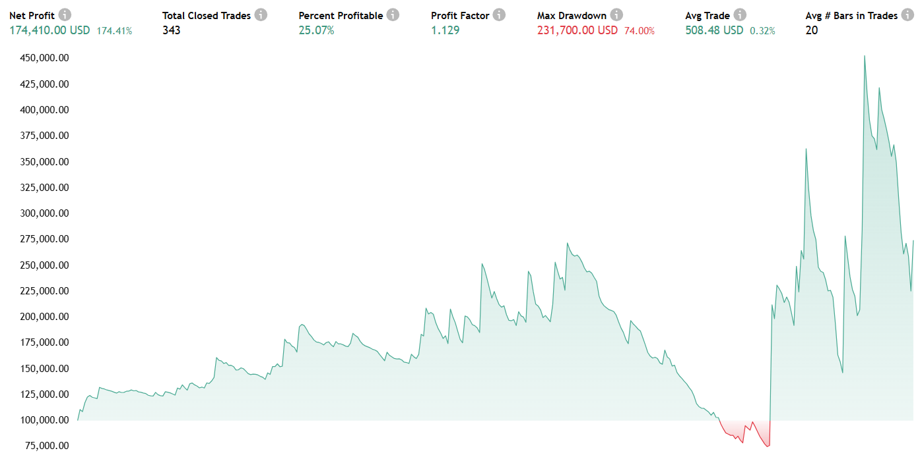
RESULTS
S&P 500 Index from Jan 1st, 1975 to Jan 1st, 2000 (dot-com bubble burst, 2002) (great recession, 2007)

Slide 5
Works really well when the market is uptrending
Will hold trades for longer because of SMA-50 indicator
Strengths
Weaknesses
Doesn’t work when market is in a downtrend
Will only cut losses when exact conditions are met
Opportunities
Optimize selling conditions for more profits
Conclusions
Good but too simple
Pros/Cons & Conclusion
Why is this strategy good, or bad

